Slide 1
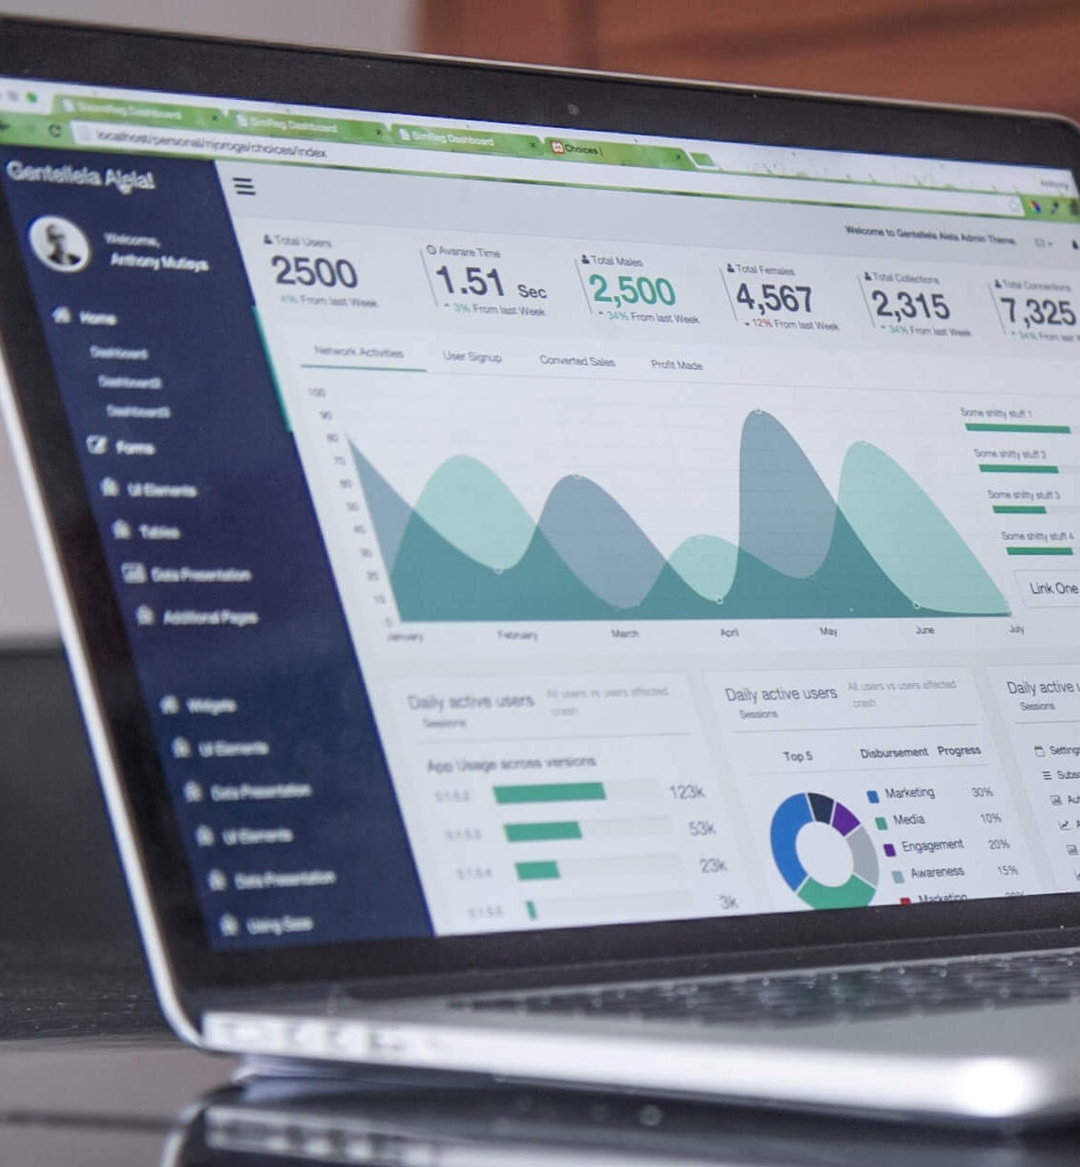
User Engagement Analysis
RESTAURANT SUCCESS

Slide 2

Introduction
About Yelp
Yelp is a platform that connects consumers with local businesses through user-generated reviews and ratings. Users can search for and discover businesses, read and write detailed reviews, and share their experiences with the community. Yelp provides comprehensive business information, including addresses, hours of operation, menus, and photos. Business owners can claim their pages to update information, respond to reviews, and engage with customers. Yelp serves as a valuable resource for finding and evaluating local businesses.

Slide 3
Agenda
This report explores the impact of user engagement on the success of restaurants, using data collected from Yelp. It delves into how user-generated reviews, ratings, and interactions on the platform influence restaurant popularity and customer loyalty. By analyzing metrics such as review counts, star ratings, and user comments, the report aims to identify key patterns and trends that contribute to a restaurant's success. The findings will provide valuable insights for restaurant owners and marketers looking to enhance their online presence and customer engagement strategies.
Problem Statement
Research Objectives
Hypothesis
Data Overview
Analysis & Findings
Recommendations

Slide 4
Problem Statement
In the highly competitive restaurant industry, understanding the key factors that drive business success is essential for stakeholders aiming to thrive in the market. Despite the wealth of customer feedback available on platforms like Yelp, many restaurant owners and marketers struggle to effectively leverage this data to enhance their business strategies. This project addresses the need to decode the complex relationship between user engagement and business success. By utilizing the Yelp dataset, we aim to investigate how various forms of user engagement—such as reviews, tips, and check-ins—correlate with critical business success metrics, including the review count and ratings of restaurants.

Slide 5
Research Objectives
Quantify the correlation between use-engagement(reviews, tips, check-ins) and review count /average star rating.
Analyze the impact of sentiment on review count and average star rating.
Time trends in user engagement.

Slide 6
Hypothesis
Higher levels of user engagement (more reviews, tips, and check-ins) correlate with higher review counts and ratings for restaurants.
Positive sentiment expressed in reviews and tips contributes to higher overall ratings and review counts for restaurants.
Consistent engagement over time is positively associated with sustained business success for restaurants.

Slide 7
Data Overview
This dataset is a subset of Yelp and has information about businesses across 8 metropolitan areas in the USA and Canada.
The original data is shared by Yelp as JSON files.
The five JSON files are business, review, user, tip and check-in.
The JSON files are stored in the database for easy retrieval of data.

Slide 8
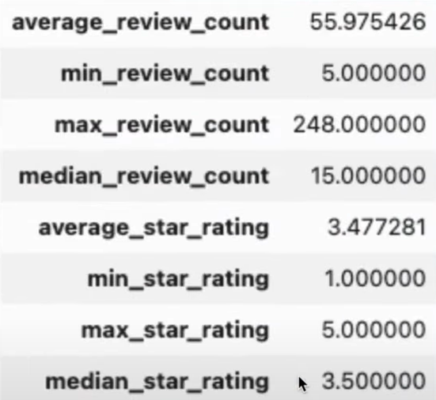
Analysis & Findings
Out of 150k businesses, 35k are restaurants business and are open.
Table showing distribution of business success metrics (review count and average rating)

Slide 9
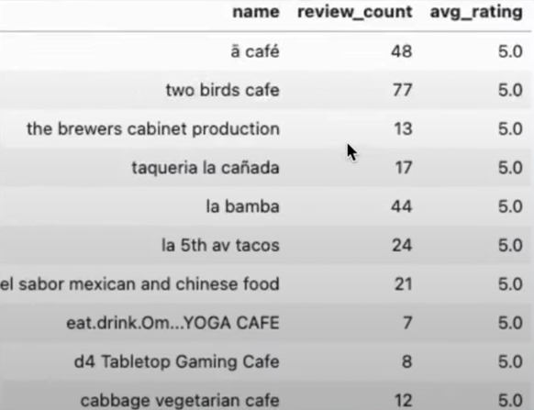
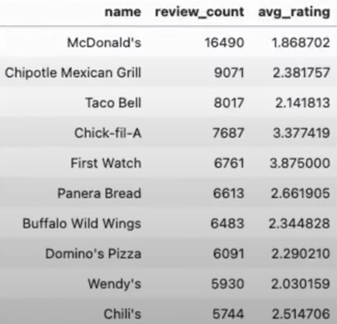
Highest Rating
Highest Review Count
Higher ratings do no guarantee a higher review count, or vice versa.
Success of Restaurants is not solely determined by ratings or review counts.
Review count reflects user engagement but not necessarily overall customer satisfaction or business performance.

Slide 10
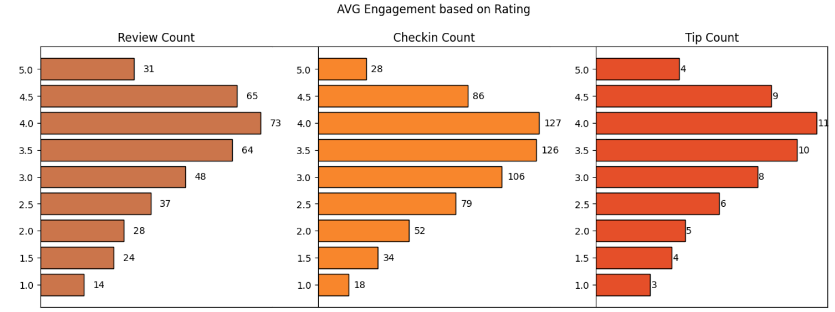
Do restaurants with higher engagement tend to have higher ratings?
• Data shows a general increase in average review, check-in, and tip counts as ratings improve from 1 to 4 stars.
• Restaurants rated 4 stars exhibit the highest engagement and shows a downward trend for rating above 4.
• The drop in engagement at 5.0 stars might suggest either a saturation point where fewer customers feel compelled to add their reviews, or a selectivity where only a small, satisfied audience frequents these establishments.

Slide 11
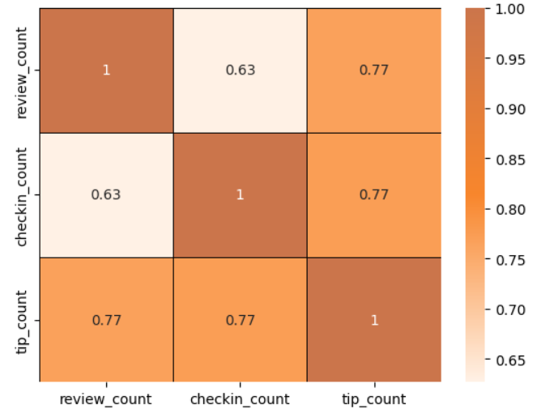
Is there a correlation between the number of reviews, tips, and check-ins for a business?
• These correlations suggest that user engagement across different platforms (reviews, tips, and check-ins) is interlinked; higher activity in one area tends to be associated with higher activity in others.
• Businesses should focus on strategies that boost all types of user engagement, increases in one type of engagement are likely to drive increases in others, enhancing overall visibility and interaction with customers.

Slide 12
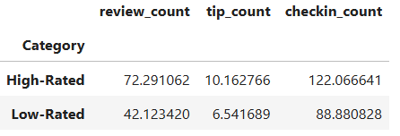
Is there a difference in the user engagement between high- rated and low-rated businesses?
• Data indicates a clear correlation between higher ratings and increased user engagement across reviews, tips, and check-ins.
• This pattern underscores the importance of maintaining high service and quality standards, as these appear to drive more reviews, check-ins, and tips, which are critical metrics of customer engagement and satisfaction.

Slide 13
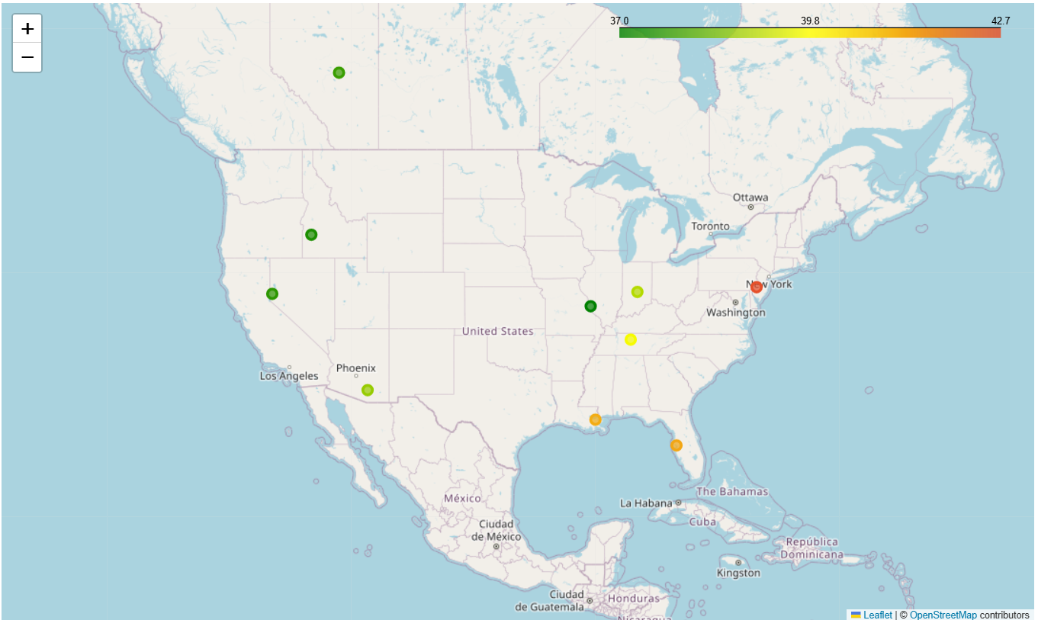
How do the success metrics of restaurants vary across different states and cities?
Philadelphia emerges as the top city with the highest success score, indicating a combination of high ratings and active user engagement.
Following Philadelphia, Tampa, Indianapolis, and Tucson rank among the top cities with significant success scores, suggesting thriving restaurant scenes in these areas.

Slide 14
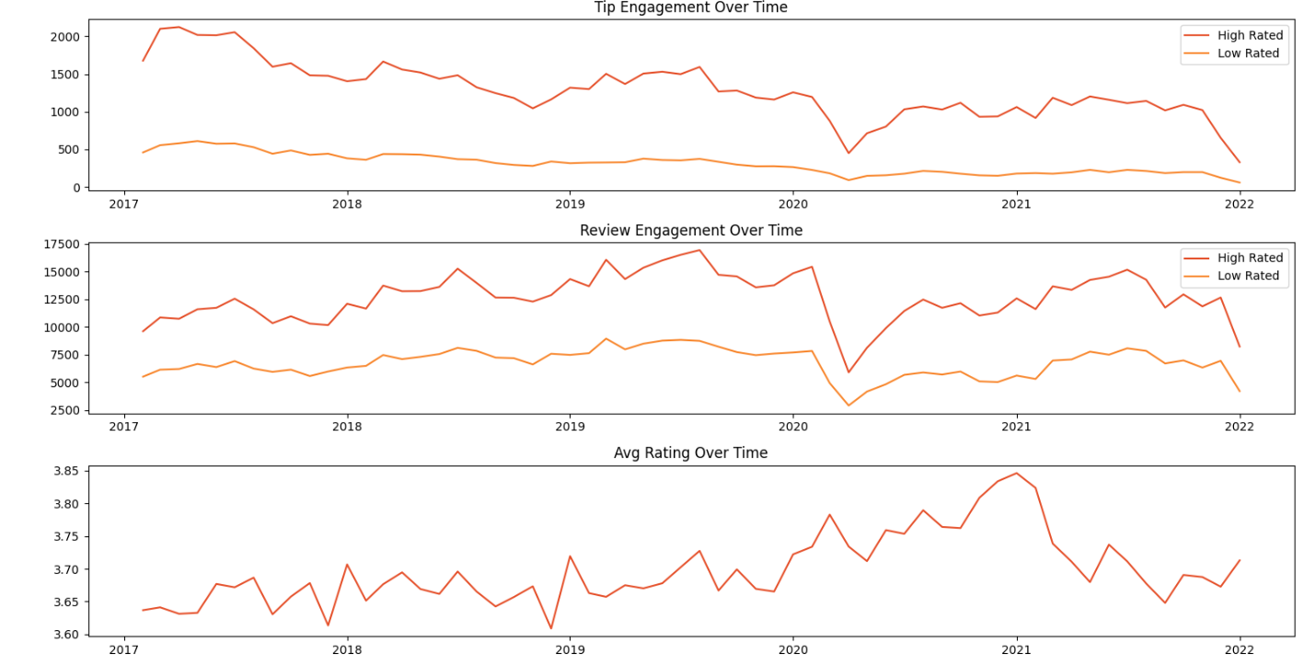
Are there any patterns in user engagement over time for successful businesses compared to less successful ones?
Successful businesses, particularly those with higher ratings (above 3.5), exhibit consistent and possibly increasing user engagement over time.
High rated restaurants maintain a steady or growing level of user engagement over time, reflecting ongoing customer interest and satisfaction.

Slide 15
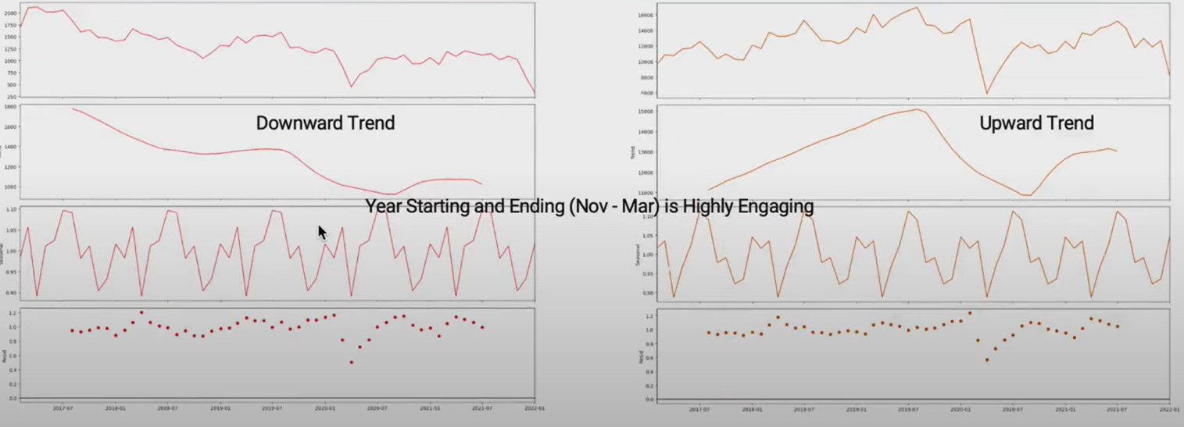
Tip Count
Trend & Seasonality Analysis
Review Count

Slide 16
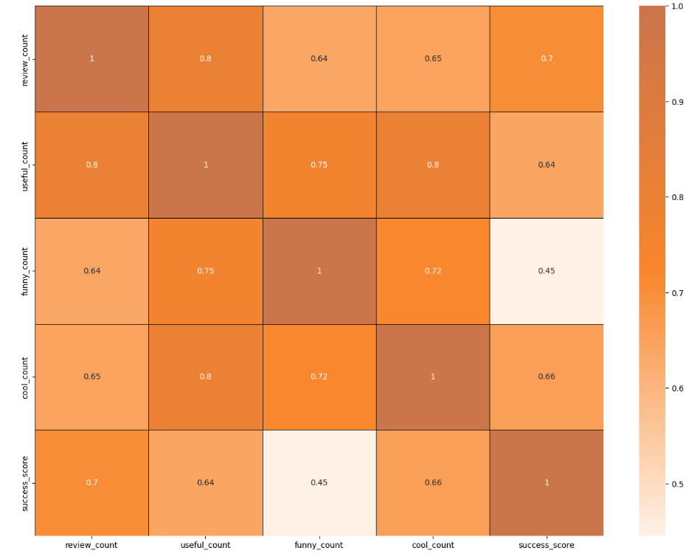
How does the sentiment of reviews and tips (useful, funny, cool) correlate with the success metrics of restaurants?
﻿•"useful," "funny," and "cool" are attributes associated with user reviews. They represent the feedback provided by provided by users about the usefulness, humor, or coolness of a particular review.
Higher counts of useful, funny, and cool reviews suggest greater user engagement and satisfaction, which are key factors contributing to a restaurant's success.

Slide 17
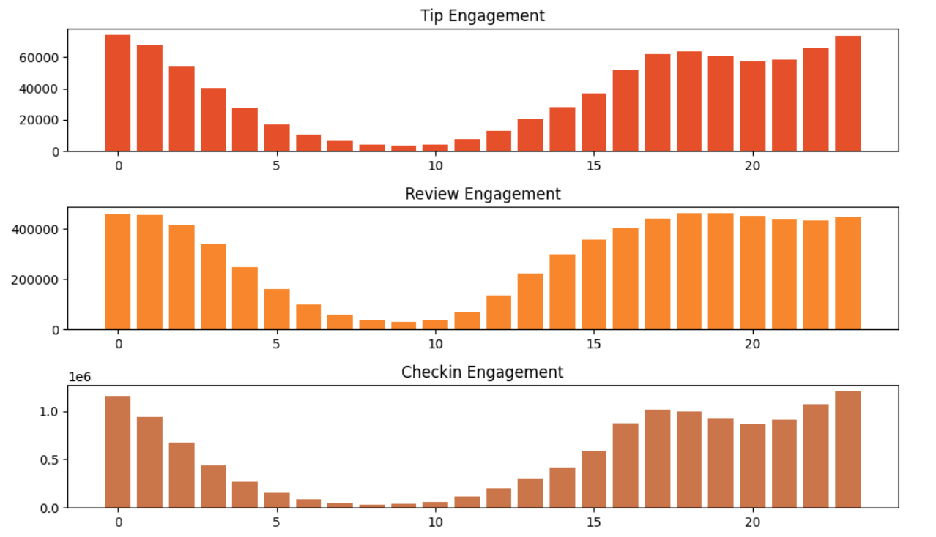
Busiest Hour
﻿The busiest hours for restaurants, based on user engagement, span from 4 pm to 1am.
Knowing the peak hours allows businesses to optimize their staffing levels and resource allocation during these times to ensure efficient operations and quality service delivery.
The concentration of user engagement during the evening and night hours suggests a higher demand for dining out during these times, potentially driven by factors such as work schedules, social gatherings, and leisure activities.

Slide 18
Recommendations
﻿Utilizing insights from the analysis of various metrics such as user engagement, sentiment of reviews, peak hours, and the impact of elite users, businesses can make informed decisions to drive success.
Collaborating with elite users and leveraging their influence can amplify promotional efforts, increase brand awareness, and drive customer acquisition.
Businesses can adjust their operating hours or introduce special promotions to capitalize on the increased demand during peak hours.
Less successful businesses may need to focus on strategies to enhance user engagement over time, such as improving service quality, responding to customer feedback.
Cities with high success scores presents opportunities for restaurant chains to expand or invest further

Slide 19

THANK
YOU
Ramesh Kumar Pandey

